Slide 1
Real World Evidence Using Measurement Values for Patient-Level Prediction Models:
a Feasibility Study
Xiaoyu (Elena) Wang
Mentors
Observational Health Data Analytics Intern
Epidemiology Team
August 1, 2023
M.S. in Statistical Science, Duke University, Grad. May 2023​
James Gilbert - Observational Health Data Analytics Jenna Reps - Observational Health Data Analytics
Anthony Sena - Observational Health Data Analytics

Slide 2
Introduction/Background
The Observational Health Data Sciences and Informatics (OHDSI) PatientLevelPrediction (PLP) framework and observational medical outcomes partnership (OMOP) common data model (CDM) support crafting of PLP models from observational healthcare data to augment real world evidence (RWE).
Models perform well using one-hot encoding based on patient medical codes.
Challenges arise when incorporating measurements into these models due to:
Non-standardization in the OMOP data model - varying and unknown units.
Sparse recording of measurements due to the observational nature of data leading to missing data.
Feasibility of including measurements in models could be explored by:
Standardizing certain data manually on a per-measurement basis.
Leveraging Bayesian inference for the coherent modeling of missing values.
Current research initiates the exploration of this feasibility by large observational healthcare data.

Slide 3
Methods Stroke in Afibrilation Patients
Logistic Regression: A machine learning method used to predict binary outcomes (yes/no, true/false, 0/1).
Example: Predict if patient has stroke.
Lasso Regression: A technique that helps to select the most important features of the dataset.
It shrinks the less important feature's coefficient to zero, thus, removing some feature altogether.
Lasso Logistic Regression: A combination of logistic regression and lasso techniques.
Uses logistic regression to predict binary outcomes.
Uses lasso regression to simplify the model by selecting the most important features only.
Benefits of Lasso Logistic Regression:
Simplicity: It provides simpler models that involve fewer variables.
Avoid Overfitting: It reduces overfitting, which is when a model is too complex and performs well on training data but poorly on unseen data.
Improve Accuracy: By only keeping the most important features, it can increase the model's accuracy.
Other Methodologies (please see more details in the poster and GitHub):
Gradient Boosting Machine (GBM): A machine learning technique for both regression and classification problems, which produces a prediction model in the form of an ensemble of weak prediction models.
Bayesian Regression for Missing Value Imputation: A statistical technique that uses probability theory to 'fill in' missing data based on what we know.

Slide 4
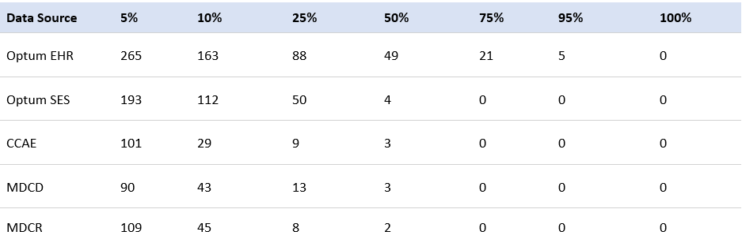
Results Pre-investigation
What’s wrong with EHR data? ☹
Table 1. Number of databases with measurements taken for at least x% of patients in the target population (patients treated for newly diagnosed stroke)
Insurance Claims data
Optum EHR: the most comprehensive coverage, recording 5 measurements for 95% or more of patients
Identified 21 measurements recorded in at least 75% of the Optum EHR target population and will be integrated for future feasibility study
Claims databases have lower coverage, lacking sufficient measurements for half or more of the patients
Only 38 measurements, including blood glucose, lipase, and iron, were recorded for at least 5% of the target population in all five databases

Slide 5
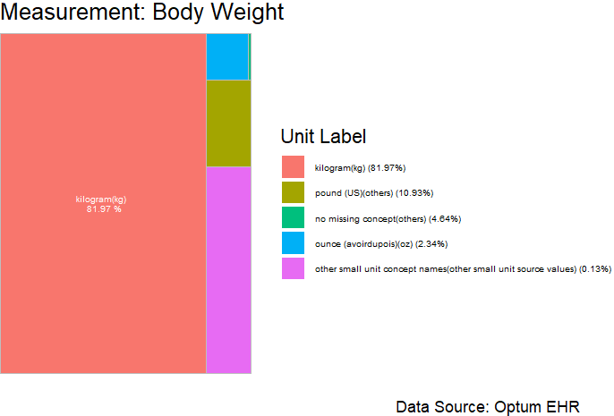
Results Pre-investigation
Figure 1. Frequency of units for measurement of body weight in Optum EHR.
Units that don’t map to standard measure concepts were merged into “No matching concept”.

Slide 6
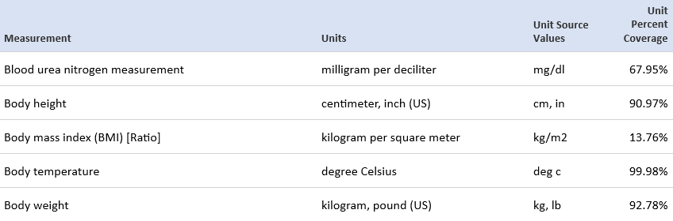
Results Pre-investigation
Can you see the issue for measurements?
Table 2. Example measurement concepts and dominant units found with for at least 75% of patients for target population in Optum EHR.
The standard unit percentage:
the total coverage that map to vocabulary concepts
(and can therefore be mapped to a common unit).

Slide 7
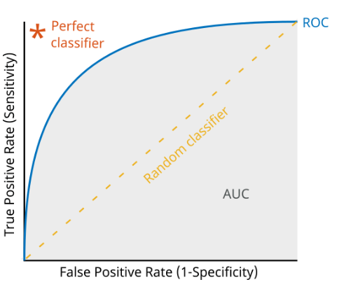
Results
Benchmark Models:
Utilized Patient-Level Prediction to fit standard models without measurements, incorporating age groups, sex, drugs, and conditions in the prior 365 days.
Measurement-Integrated Models:
Developed models incorporating 21 standard measurements along with age groups, sex, drugs, and conditions from the past year, standardizing each measurement and imputing average value where data was absent.
Performance Metrics:
Area Under the Receiver Operating Characteristic Curve (AUC-ROC):
ROC plot shows how well a model can classify true positives and true negatives. A good ROC plot hugs the top left corner, meaning the model correctly classifies real events.
The AUC score quantifies this by ranging from 0.5 (no better than random guessing) to 1 (perfect classification). A good AUC score is close to 1, showing that our model can differentiate classes well.
Other Techniques (please see more details in the poster and GitHub):
calibration in the large, net benefit, integrated discrimination improvement, and net reclassification improvement, maintaining consistent test/train split.

Slide 8
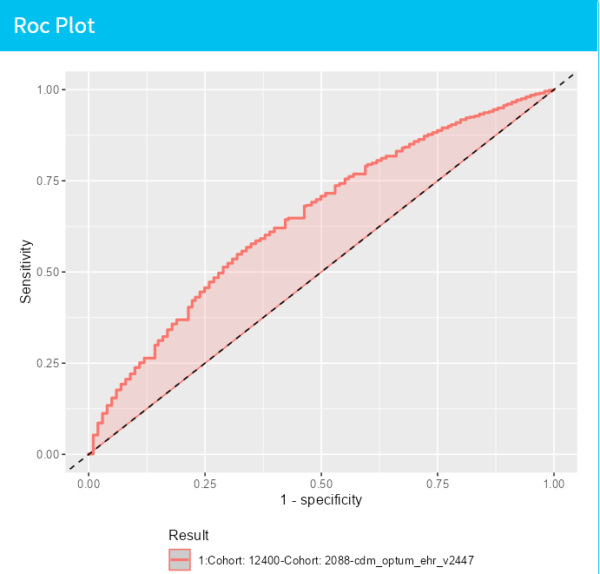

Results
Figure 2. Benchmark:
LASSO Regression Model Validation ROC Plot
AUCROC: 0.654 (0.644-0.67)
Figure 3. Measurement-Integrated: LASSO Regression Model
Validation ROC Plot
AUCROC: 0.652 (0.642-0.66)
Both methods were effective in differentiating health conditions, matching the established CHADs method.
LASSO demonstrated a good predictive accuracy across various probability thresholds.
From other performance metrics, measurement-integrated models has potential improvement and stability in predictions despite similar performance was observed between them.
(more details in the poster & GitHub)

Slide 9
Summary
Preliminary analysis of five datasets revealed that >=50% of the target population lack sufficient recorded measurements in claims data, which might affect the prediction models and external validation. Datasets often have inconsistent or missing units, necessitating manual standardization. Optum EHR stands out as the most suitable for developing prediction models, as it allows the inclusion of 21 measurements that are present in >=75% of the target population.
Benchmark Models: Utilized Patient-Level Prediction to fit models using age, sex, drugs, and conditions from the past year, without considering measurements.
Measurement-Integrated Models: Developed models incorporating 21 standard measurements alongside age, sex, drugs, and conditions, standardizing and imputing missing data.
Both methods (Benchmark and Measurement-Integrated) were effective. LASSO Regression showed good predictive accuracy across various probability thresholds. Measurement-integrated models demonstrated potential for improvement and stability in predictions.

Slide 10
Future Directions
Explore and deepen the understanding of Bayesian methodologies to navigate challenges of non-standardization and data sparseness.
Improve data integration processes, such as utilizing natural language processing, to enhance measurements' data quality, potentially leading to better model development and prediction accuracy.
Rigorously calibrate and validate models on diverse patient populations to improve the generalizability and robustness of predictions.
Foster synergy between machine learning approaches and medical domain knowledge to refine predictive models.
Develop robust, accurate, and clinically applicable predictive models to assist healthcare professionals in informed decision-making.

Slide 11
Acknowledgements
Xiaoyu Wang^{1,2}, Jenna Reps^{1,3}, Anthony Sena^{1,3}, James P. Gilbert¹, Marc A Suchard^{4,5}
¹Janssen Research and Development, Titusville, NJ,
²Statistical Science Department, Duke University, Durham, NC,
³Department of Medical Informatics, Erasmus University Medical Center, Rotterdam, the Netherlands
⁴VA Informatics and Computing Infrastructure, US Department of Veterans Affairs, Salt Lake City, UT
⁵Department of Biostatistics, University of California, Los Angeles, CA
All the people who contributed to make this internship an amazing experience by their efforts, discussion, help from…​
Patrick Ryan
Christopher Knoll
Martijn Schuemie
Erica Voss
Joel Swerdel
Frank Defalco
Gowtham Rao
Nathan Hall
Julia Capperella
… and all others from EPI & OHDA fantastic team!
​
Big Thank You!
If you have any question or want to discuss more, Please contact @ ewang17@its.jnj.com ☺

Slide 12
